Slide 1
Vertical Circular Motion

Slide 2
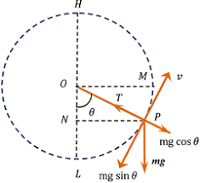
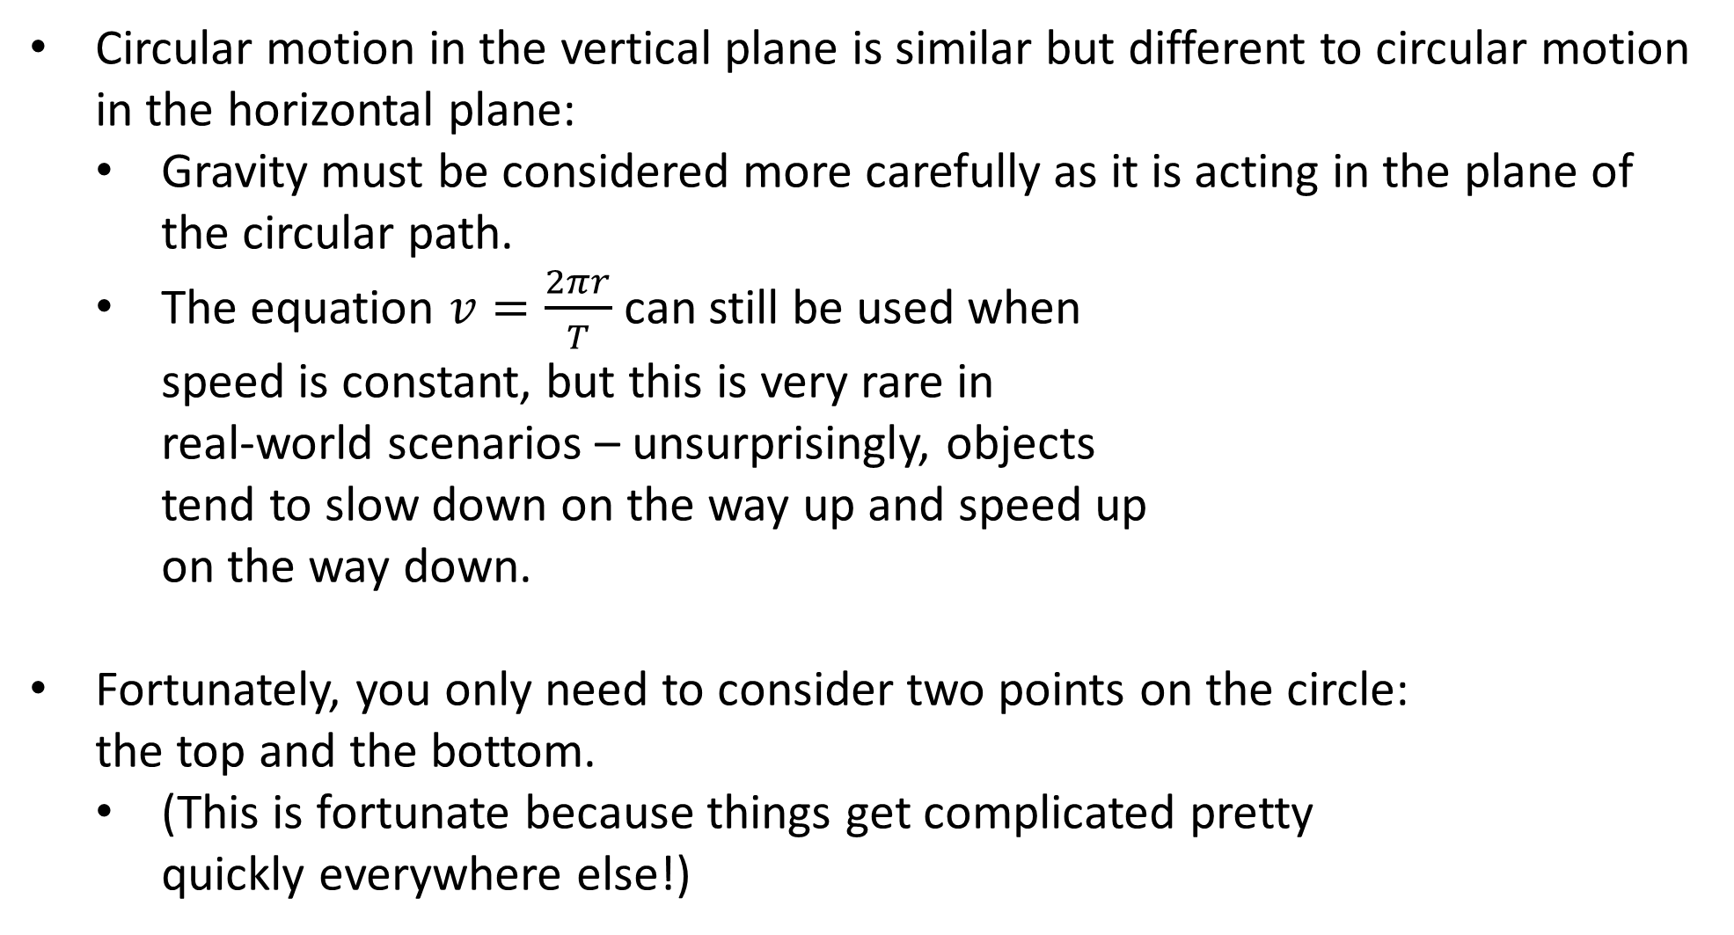
Vertical Circular Motion
Circular motion in the vertical plane is similar but different to circular motion in the horizontal plane:
Gravity must be considered more carefully as it is acting in the plane of the circular path.
The equation $v=\frac{2πr}{T}$ can still be used when speed is constant, but this is very rare in real-world scenarios – unsurprisingly, objects tend to slow down on the way up and speed up on the way down.
Fortunately, you only need to consider two points on the circle: the top and the bottom.
(This is fortunate because things get complicated pretty quickly everywhere else!)

Slide 3
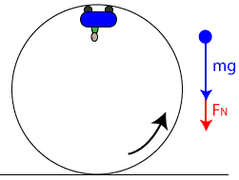
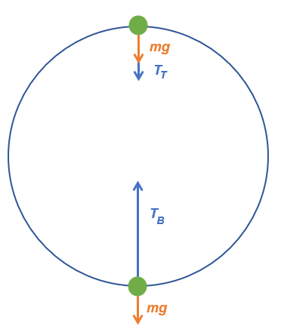
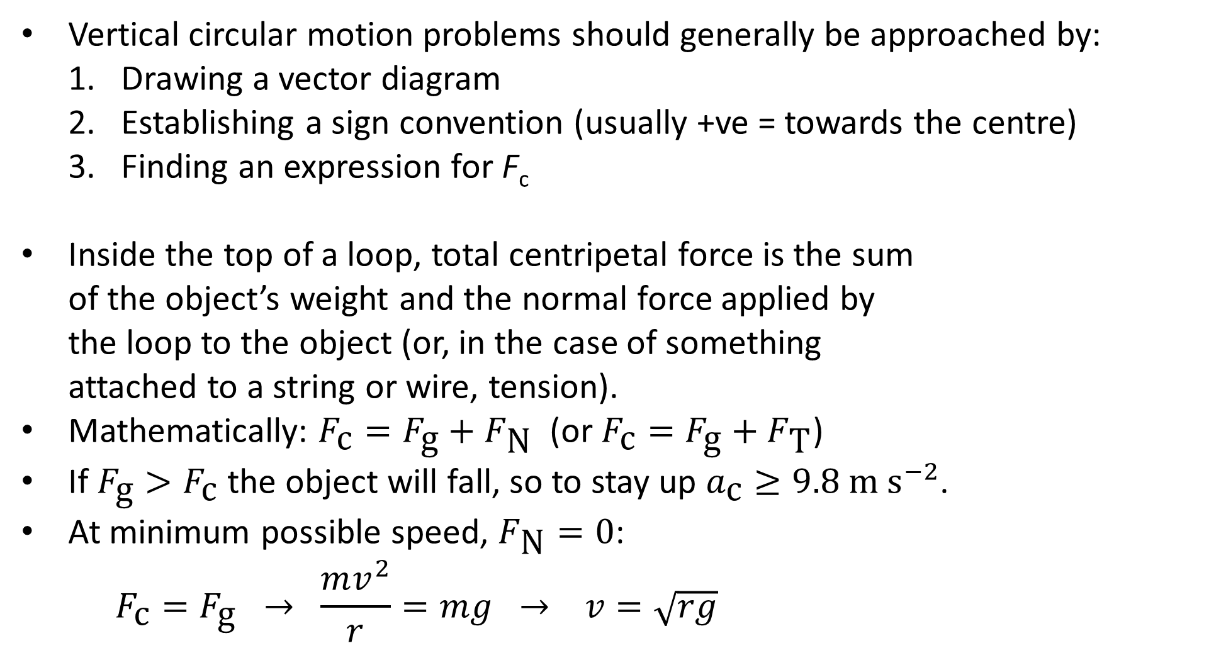
Vertical Circular Motion: Inside the Top
Vertical circular motion problems should generally be approached by:
Drawing a vector diagram
Establishing a sign convention (usually +ve = towards the centre)
Finding an expression for F_{c}
Inside the top of a loop, total centripetal force is the sum of the object’s weight and the normal force applied by the loop to the object (or, in the case of something attached to a string or wire, tension).
Mathematically: $F_{\text{c}}=F_{\text{g}}+F_{\text{N}}$ (or $F_{\text{c}}=F_{\text{g}}+F_{\text{T}}$)
If $F_{\text{g}}>F_{\text{c}}$ the object will fall, so to stay up $a_{\text{c}}≥9.8 \text{m} {\text{s}}^{−2}$.
At minimum possible speed, $F_{\text{N}}=0$:
$$F_{\text{c}}=F_{\text{g}} → \frac{mv^{2}}{r}=mg → v=\sqrt{rg}$$
Notes:
T_{T} in the second diagram is tension at the top.

Slide 4
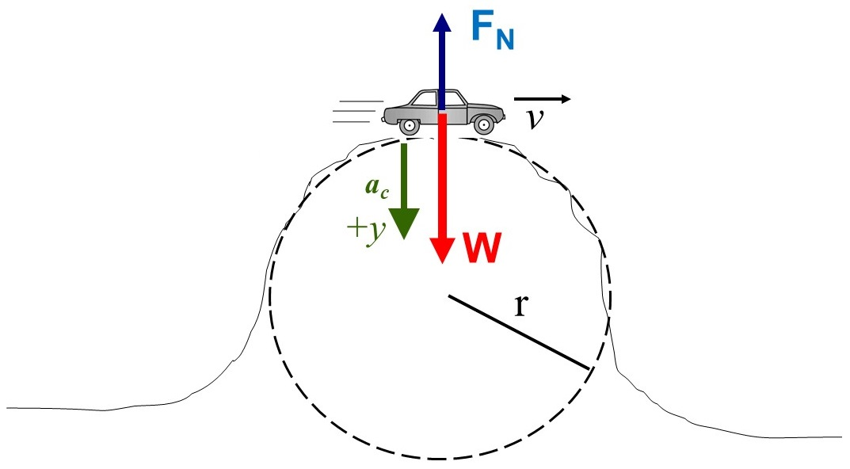
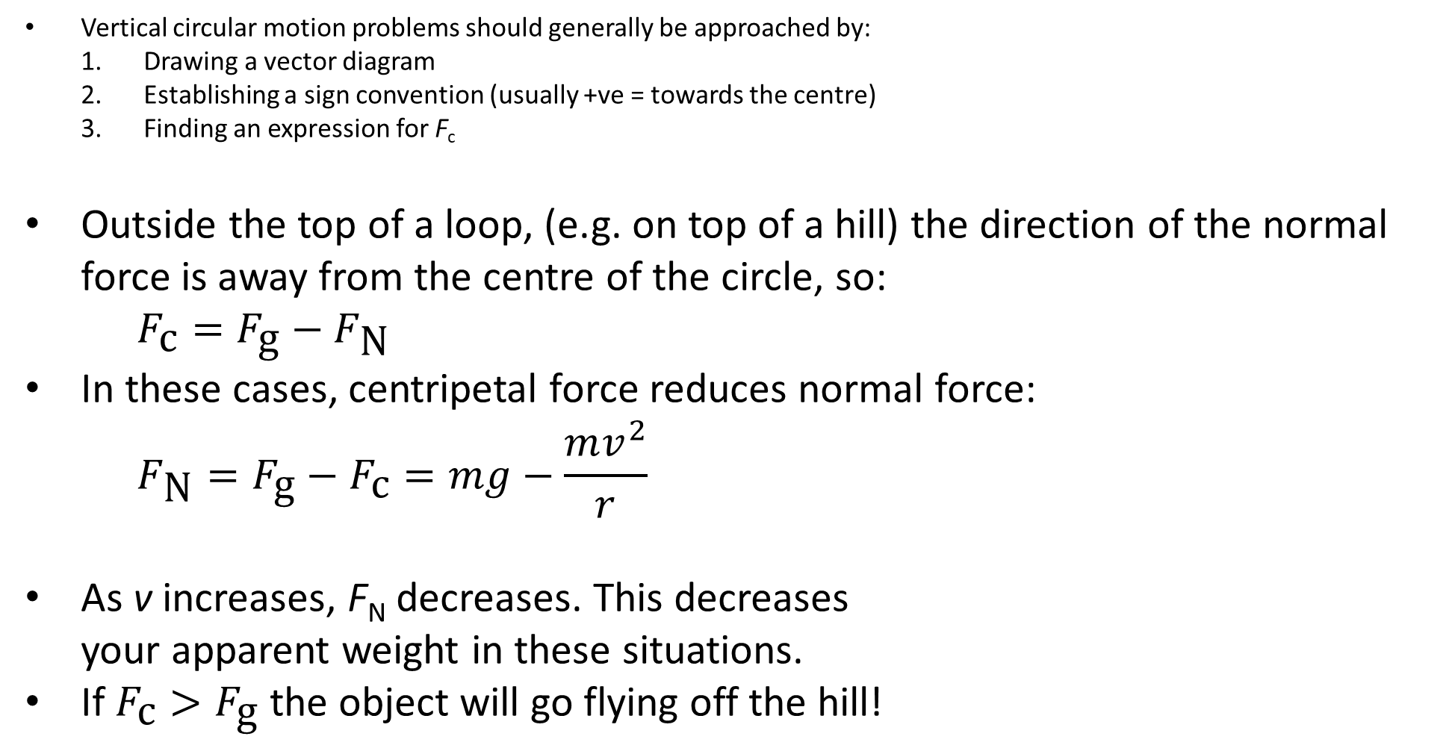
Vertical Circular Motion: Outside the Top
Vertical circular motion problems should generally be approached by:
Drawing a vector diagram
Establishing a sign convention (usually +ve = towards the centre)
Finding an expression for F_{c}
Outside the top of a loop, (e.g. on top of a hill) the direction of the normal force is away from the centre of the circle, so:
$$F_{\text{c}}=F_{\text{g}}−F_{\text{N}}$$
In these cases, centripetal force reduces normal force:
$$F_{\text{N}}=F_{\text{g}}−F_{\text{c}}=mg−\frac{mv^{2}}{r}$$
As v increases, F_{N} decreases. This decreases your apparent weight in these situations.
If $F_{\text{c}}>F_{\text{g}}$ the object will go flying off the hill!
Notes:
Much like going down in an elevator, some of your weight force is providing centripetal force, hence the reduction in normal force.
Example: driving over a road with a large camber

Slide 5
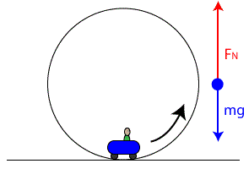
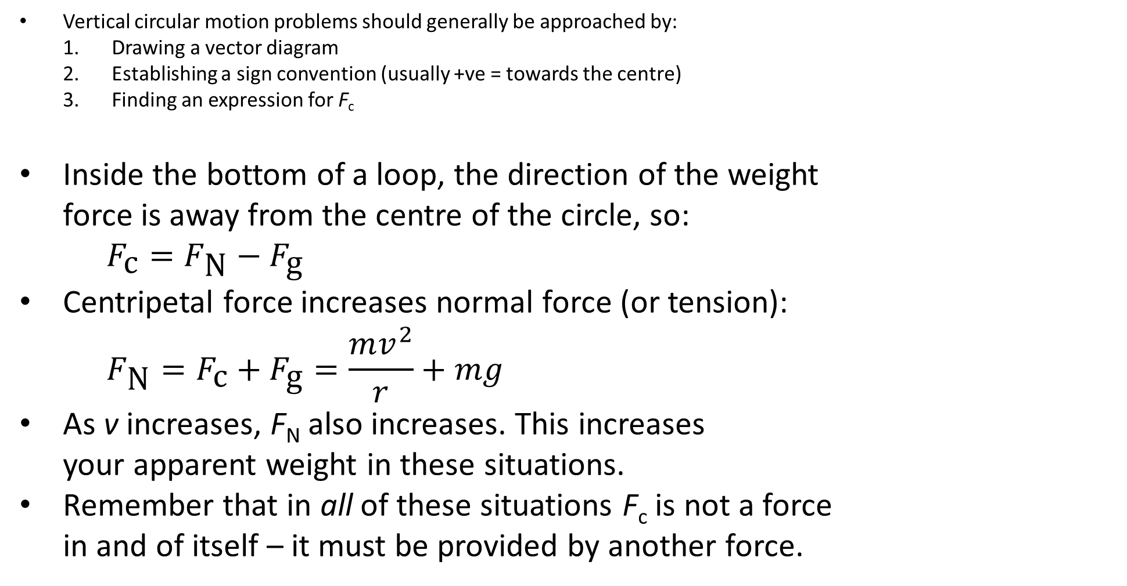
Vertical Circular Motion: Inside the Bottom
Vertical circular motion problems should generally be approached by:
Drawing a vector diagram
Establishing a sign convention (usually +ve = towards the centre)
Finding an expression for F_{c}
Inside the bottom of a loop, the direction of the weight force is away from the centre of the circle, so:
$$F_{\text{c}}=F_{\text{N}}−F_{\text{g}}$$
Centripetal force increases normal force (or tension):
$$F_{\text{N}}=F_{\text{c}}+F_{\text{g}}=\frac{mv^{2}}{r}+mg$$
As v increases, F_{N} also increases. This increases your apparent weight in these situations.
Remember that in all of these situations F_{c} is not a force in and of itself – it must be provided by another force.
Notes:
T_{B} in the second diagram is tension at the bottom.

Slide 6
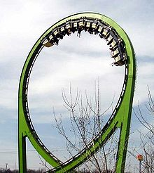
Example #1
What is the minimum speed a roller coaster needs at the top of a 16.0 m wide loop to ensure that it stays on the track?
Notes:
8.85 m s⁻¹

Slide 7
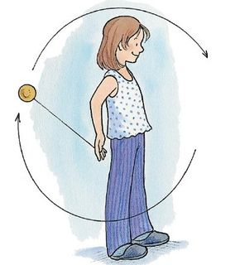
Example #2
A yoyo has a mass of 120 g and swings at the end of a string 65.0 cm in length. A girl swings the yoyo in the air in a vertical circle with a speed of 3.50 m s⁻¹.
What would be the tension in the yoyo string when it is at the bottom of its circular swing?
Notes:
3.44 N

Slide 8
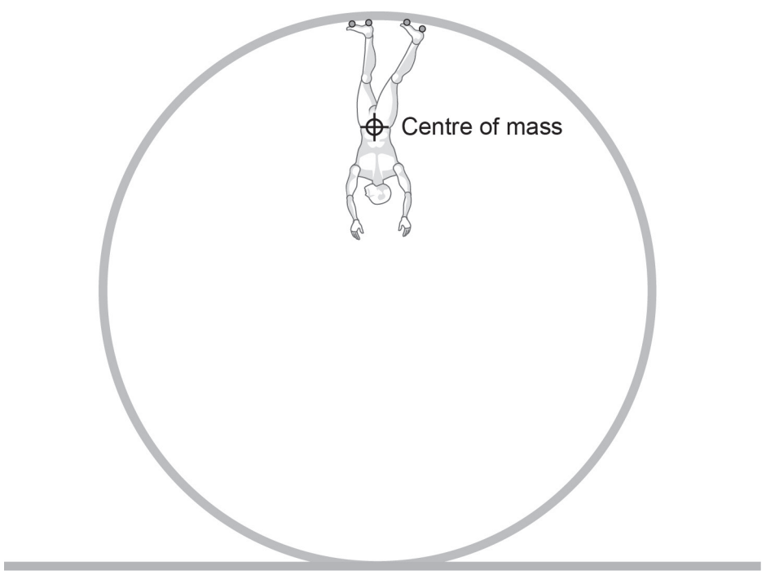
Example #3
A 53 kg skater is attempting to complete a loop that is 2.50 m in radius. Estimate the minimum speed at the top of the loop needed for the skater to maintain contact with the top of the loop.
Notes:
Answers should be between 3.5-4.1 m s⁻¹
(Q13 in 2016 ATAR exam)

Slide 9
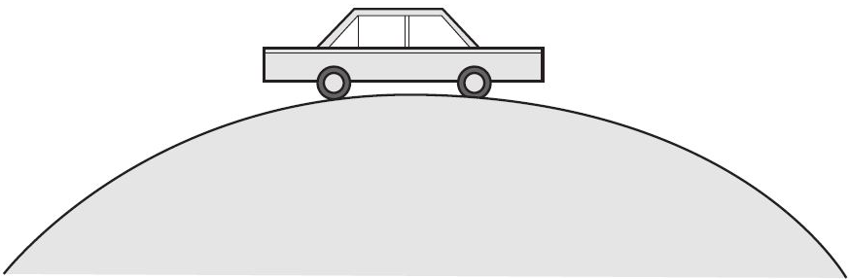
Example #4
A car is driving over a hill with a radius of 250 m at a speed of 30.0 m s⁻¹. Determine the magnitude of the net force experienced between a 65.0 kg passenger and their seat or seat belt.
Notes:
403 N
(Q6 in 2013 ATAR exam)

